Slide 1
Core Java – Class 4

Slide 2
Topics
TDD
Constructor
Destructor
OOPS – Inheritance
OOPS – Polymorphism
Final classes

Slide 3
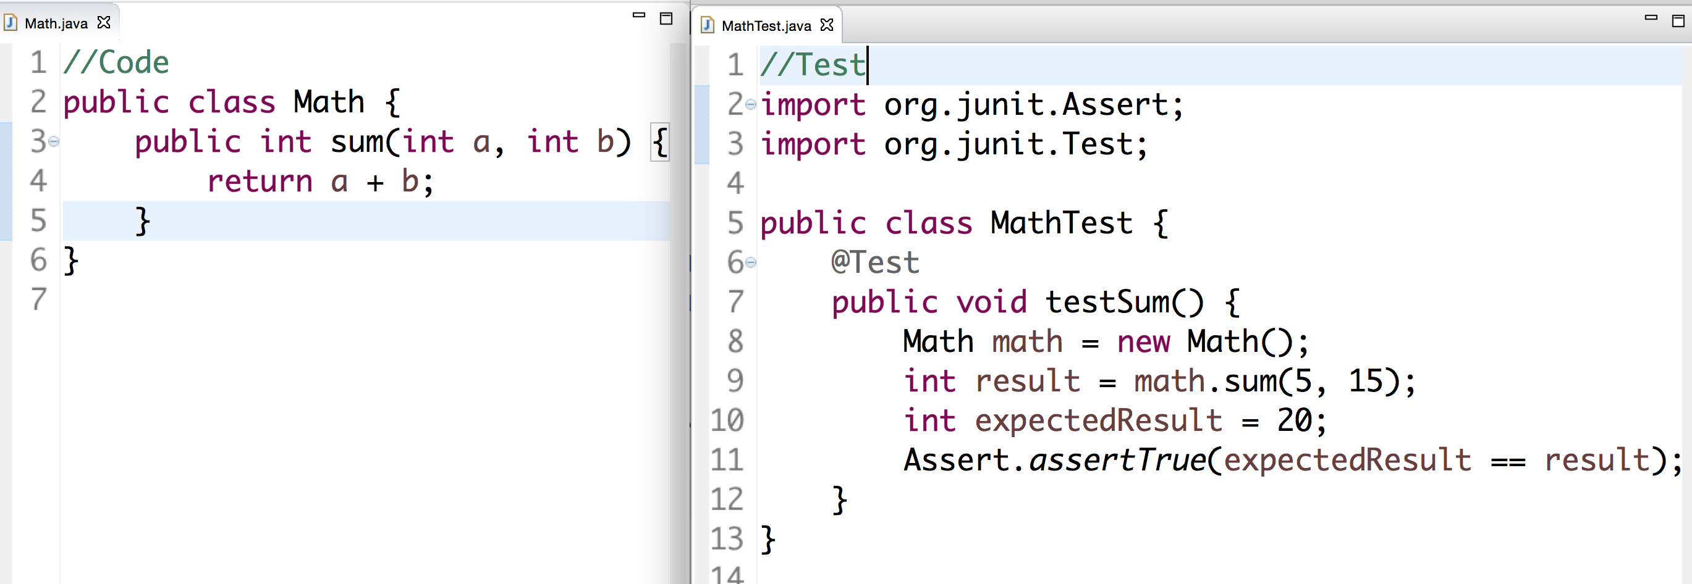
TDD
TDD : Test Driven Development
Testing is a mechanism to certify a piece of logic or code or functionality
Testing can be manual (System.out.println) or Automated
What if Test can also be a code
Junit is a mechanism to test the Java code
TDD is a philosophy where we write the Test first before writing code
TDD helps catch critical bugs and ensures that other engineers don’t create bugs
Tests act like Insurance for the Code

Slide 4
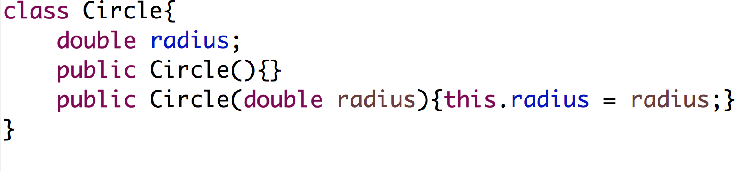
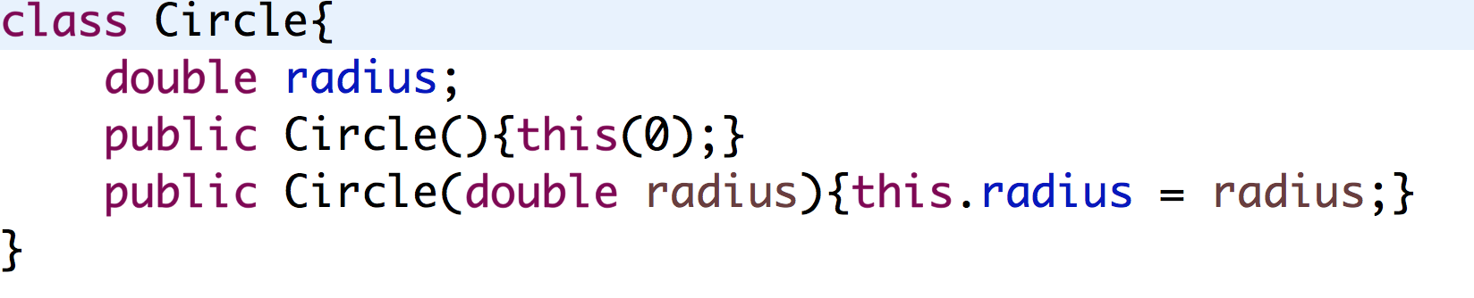
Constructor
Constructor is a behavior that gets invoked when an object is created
Constructors can have parameters or no parameters
Java provides a default constructor
Constructors don’t return any value
this is a special keyword that can be used to access instance variables in the class – it is helpful to use when the name of the parameter is same as instance variable
One constructor can be invoked from another constructor using this()

Slide 5
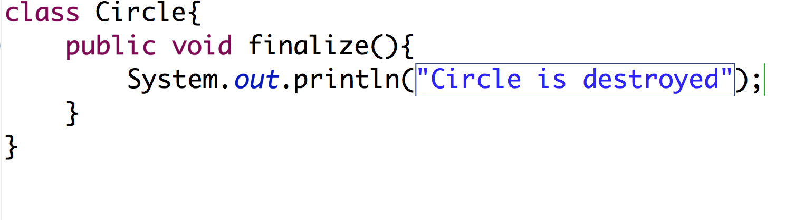
Destructor
Destructor gets invoked when an object is garbage collected or not referenced by any pointer
Any specific logic to be executed when destroying the object needs to be written in finalize() method
However, it’s not guaranteed that logic will be executed immediately after an Object is destroyed
Garbage collector can be forced to execute using System.gc() and that would result the destructor
Good part of Java – No need to free the memory when an object is destroyed.
Java will automatically free the space (Garbage Collector)

Slide 6
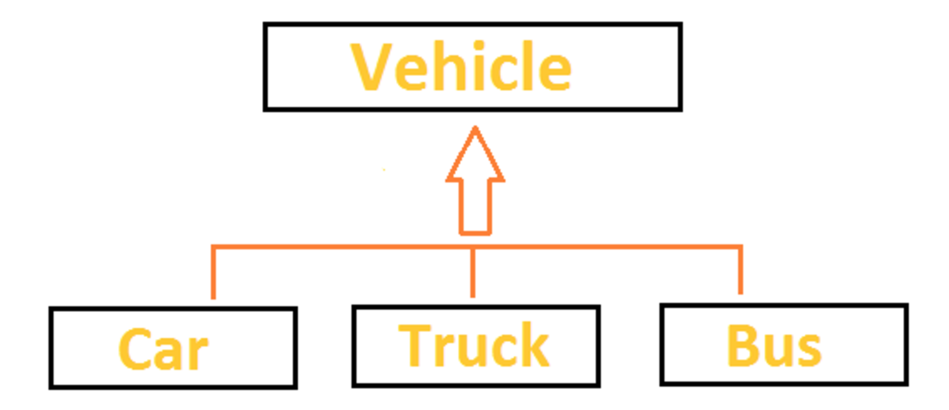
Inheritance
Inheritance is a mechanism to reuse the code written in one class by another class
Inheritance is a relation between two classes. For eg:- Car is a Vehicle, Bus is a Vehicle

Slide 7
Terminology
Inheritance is a fundamental Object Oriented concept
A class can be defined as a "subclass" of another class.
The subclass inherits all data attributes of its superclass
The subclass inherits all methods of its superclass
The subclass inherits all associations of its superclass
The subclass can:
Add new functionality
Use inherited functionality
Override inherited functionality
superclass:
Person
- name: String
- dob: Date
subclass:
Employee
- employeeID: int
- salary: int
- startDate: Date

Slide 8
What really happens?
When an object is created using new, the system must allocate enough memory to hold all its instance variables.
This includes any inherited instance variables
In this example, we can say that an Employee "is a kind of" Person.
An Employee object inherits all of the attributes, methods and associations of Person
Person
- name: String
- dob: Date
Person
name = "John Smith"
dob = Jan 13, 1954
Employee
name = "Sally Halls"
dob = Mar 15, 1968
employeeID = 37518
salary = 65000
startDate = Dec 15, 2000
is a kind of
Employee
- employeeID: int
- salary: int
- startDate: Date

Slide 9
Inheritance in Java
Inheritance is declared using the "extends" keyword
If inheritance is not defined, the class extends a class called Object
public class Person
{
private String name;
private Date dob;
[...]
Person
- name: String
- dob: Date
public class Employee extends Person
{
private int employeID;
private int salary;
private Date startDate;
[...]
Employee
- employeeID: int
- salary: int
- startDate: Date
Employee anEmployee = new Employee();

Slide 10
Inheritance Hierarchy
Each Java class has one (and only one) superclass.
C++ allows for multiple inheritance
Inheritance creates a class hierarchy
Classes higher in the hierarchy are more general and more abstract
Classes lower in the hierarchy are more specific and concrete
There is no limit to the number of subclasses a class can have
There is no limit to the depth of the class tree.
Class
Class
Class
Class
Class
Class
Class
Class

Slide 11
The class called Object
At the very top of the inheritance tree is a class called Object
All Java classes inherit from Object.
All objects have a common ancestor
This is different from C++
The Object class is defined in the java.lang package
Examine it in the Java API Specification
Object

Slide 12
Constructors and Initialization
Classes use constructors to initialize instance variables
When a subclass object is created, its constructor is called.
It is the responsibility of the subclass constructor to invoke the appropriate superclass constructors so that the instance variables defined in the superclass are properly initialized
Superclass constructors can be called using the "super" keyword in a manner similar to "this"
It must be the first line of code in the constructor
If a call to super is not made, the system will automatically attempt to invoke the no-argument constructor of the superclass.

Slide 13
Constructors - Example
public class BankAccount
{
private String ownersName;
private int accountNumber;
private float balance;
public BankAccount(int anAccountNumber, String aName)
{
accountNumber = anAccountNumber;
ownersName = aName;
}
[...]
}
public class OverdraftAccount extends BankAccount
{
private float overdraftLimit;
public OverdraftAccount(int anAccountNumber, String aName, float aLimit)
{
super(anAccountNumber, aName);
overdraftLimit = aLimit;
}
}

Slide 14
Method Overriding
Subclasses inherit all methods from their superclass
Sometimes, the implementation of the method in the superclass does not provide the functionality required by the subclass.
In these cases, the method must be overridden.
To override a method, provide an implementation in the subclass.
The method in the subclass MUST have the exact same signature as the method it is overriding.

Slide 15
Method overriding - Example
public class BankAccount
{
private String ownersName;
private int accountNumber;
protected float balance;
public void deposit(float anAmount)
{
if (anAmount>0.0)
balance = balance + anAmount;
}
public void withdraw(float anAmount)
{
if ((anAmount>0.0) && (balance>anAmount))
balance = balance - anAmount;
}
public float getBalance()
{
return balance;
}
}

Slide 16
Method overriding - Example
public class OverdraftAccount extends BankAccount
{
private float limit;
public void withdraw(float anAmount)
{
if ((anAmount>0.0) && (getBalance()+limit>anAmount))
balance = balance - anAmount;
}
}

Slide 17
Object References and Inheritance
Inheritance defines "a kind of" relationship.
In the previous example, OverdraftAccount "is a kind of" BankAccount
Because of this relationship, programmers can "substitute" object references.
A superclass reference can refer to an instance of the superclass OR an instance of ANY class which inherits from the superclass.
BankAccount anAccount = new BankAccount(123456, "Craig");
BankAccount account1 = new OverdraftAccount(3323, "John", 1000.0);
BankAccount
name = "Craig"
accountNumber = 123456
anAccount
OverdraftAccount
name = "John"
accountNumber = 3323
limit = 1000.0
account1

Slide 18
Polymorphism
In the previous slide, the two variables are defined to have the same type at compile time: BankAccount
However, the types of objects they are referring to at runtime are different
What happens when the withdraw method is invoked on each object?
anAccount refers to an instance of BankAccount. Therefore, the withdraw method defined in BankAccount is invoked.
account1 refers to an instance of OverdraftAccount. Therefore, the withdraw method defined in OverdraftAccount is invoked.
Polymorphism is: The method being invoked on an object is determined AT RUNTIME and is based on the type of the object receiving the message.

Slide 19
Final Methods and Final Classes
Methods can be qualified with the final modifier
Final methods cannot be overridden.
This can be useful for security purposes.
public final boolean validatePassword(String username, String Password)
{
[...]
Classes can be qualified with the final modifier
The class cannot be extended
This can be used to improve performance. Because there an be no subclasses, there will be no polymorphic overhead at runtime.
public final class Color
{
[...]

Slide 20
Review
What is inheritance? What is a superclass? What is a subclass?
Which class is at the top of the class hierarchy in Java?
What are the constructor issues surrounding inheritance?
What is method overriding? What is polymorphism? How are they related?
What is a final method? What is a final class?

